Slide 1



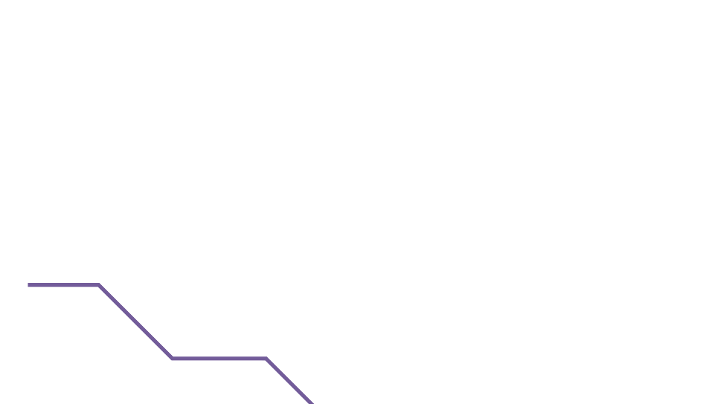
Chapter #1
Why Do We Need Money?
1.0 Introduction
1.1 Meet Satoshi
Activity: Five Questions on Money
1.2 Class Discussion— Why Do We Need Money?
Student Workbook
English Version | 2025

Slide 2






Why Do We Need Money?
Chapter #1
1.0 Introduction
1.1 Meet Satoshi
Money is one of the greatest instruments of freedom ever invented by man.
Friedrich Hayek
Hi! I’m Satoshi, an interactive assistant who will help you throughout the Bit- coin Diploma. I will give you resources and helpful recommendations so you can take a closer look at key concepts.
Activity: Let's Start the Chapter by Answering the Five Questions Below:
Consider practical uses like acquiring necessities such as food and desired items. Try to be speciﬁc in your examples, balancing creativity with realism.
Welcome to the Bitcoin Diploma. In this chapter, we'll explore the fundamental question of why money is essential in our lives. We'll look into the nature of money and its various forms, aiming to gain a deeper understanding of its signiﬁcance. Money is something we use almost every day, but do we actually understand why we need it and what it is? Why do our parents and other family members trade their time for money? Why do some people have more of it than others? Why is money diﬀerent in other countries? Why can’t we just create more of it when we need it?
01

Slide 3
Why Do We Need Money?
Chapter #1
Why do we need money?
Who controls money?
What is money?
What gives money its “value”?
02

Slide 4




Why Do We Need Money?
Chapter #1
What question do you have about money? Write down your question here to share with the class.
Expand the discussion to the whole class, sharing and comparing lists to determine the ﬁve most essential reasons for needing money. Identify common ideas across the class. Reﬂect on your individual unique ideas that didn't make the list but are worth considering. Jot down these additional
insights
1.2 Class Discussion —
Why Do We Need Money?
The Class will split into groups and:
Share and discuss their answers to the ﬁrst four questions. Write down their favorite answers.
Share their answers to the last question and vote for one favorite student-question. Write down the result.
Revisit their answers and questions at the end of the Bitcoin Diploma.
Now that you have a clearer understanding of why money is necessary, the upcoming chapters will explore what money is, how it evolved over time, who inﬂuences it, and its newest form. Keep referring to your lists from this ﬁrst day in class to draw connections between your insights and the evolution of money’s creation, deﬁnition, and usage over time.
03

